Slide 1
HTML Form Elements

Slide 2
Objectives
Basic Elements
Attributes
Comments
<select>
<textarea>
<Button>
<input>

Slide 3
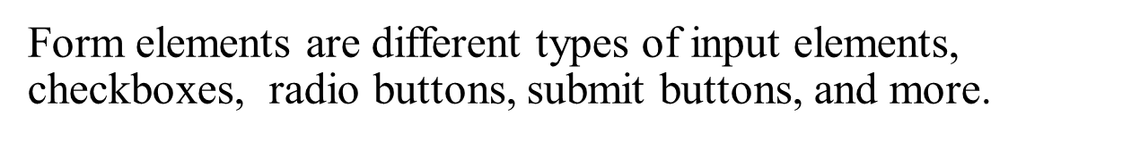
HTML Form Elements
The <form> Element
HTML forms are used to collect user input. The <form> element defines an HTML form:
<form>
.
form elements
.
</form>
HTML forms contain form elements.

Slide 4
HTML Form Attributes
An HTML <form> element, with all possible attributes set, will look like this:
<form action="action_page.php" method="post" target="_blank" a
ccept-charset="UTF-8" enctype="application/x-www-form- urlencoded" autocomplete="off" novalidate>
.
form elements
.
</form>

Slide 5
Here is the list of <form> attributes:
HTML Form Attributes
Attribute | Description
accept-charset | Specifies the charset used in the submitted form (default: the page charset).
action | Specifies an address (url) where to submit the form (default: the submitting page).
autocomplete | Specifies if the browser should autocomplete the form (default: on).
enctype | Specifies the encoding of the submitted data (default: is url- encoded).
method | Specifies the HTTP method used when submitting the form (default: GET).
name | Specifies a name used to identify the form (for DOM usage: document.forms.name).
novalidate | Specifies that the browser should not validate the form.

Slide 6
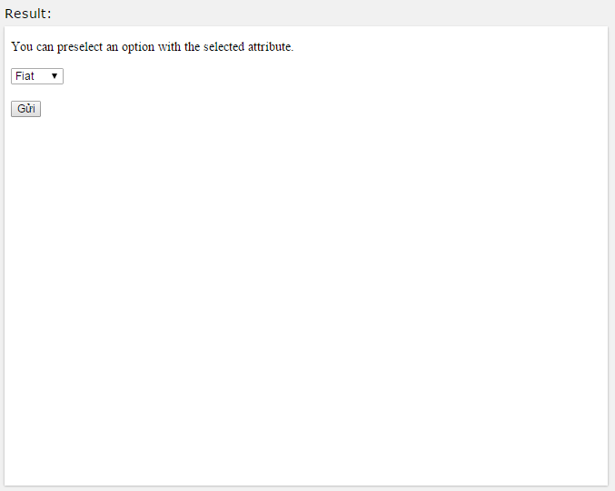
The <select> Element (Drop-Down List)
The <select> element defines a drop-down list:
Example
<select name="cars">
<option value="volvo">Volvo</option>
<option value="saab">Saab</option>
<option value="fiat">Fiat</option>
<option value="audi">Audi</option>
</select>

Slide 7
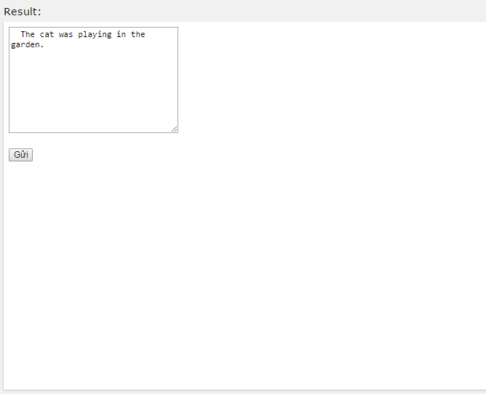
The <textarea> Element
The <textarea> element defines a multi-line input field (a text area):
<textarea name="message" rows="10" cols="30">
The cat was playing in the garden.
</textarea>

Slide 8
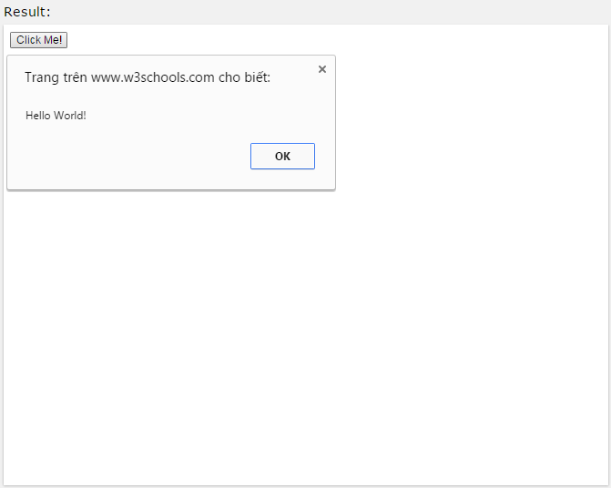
The <button> Element
The <button> element defines a clickable button:
<button type="button" onclick="alert('Hello World!')">Click
Me!</button>

Slide 9
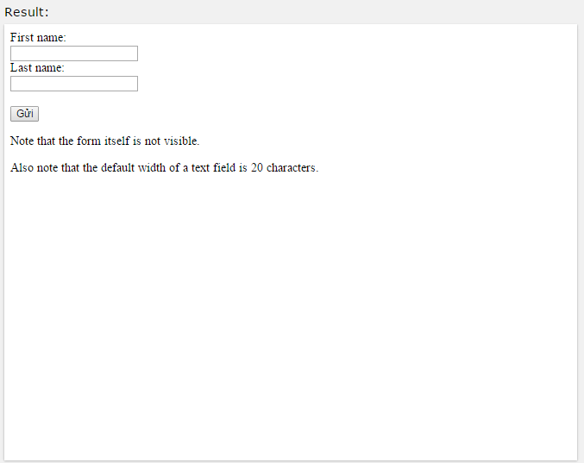
HTML Input
Input Type: text
<input type="text"> defines a one-line input field for text input:
<form>
First name:<br>
<input type="text" name="firstname"><br> Last name:<br>
<input type="text" name="lastname">
</form>

Slide 10
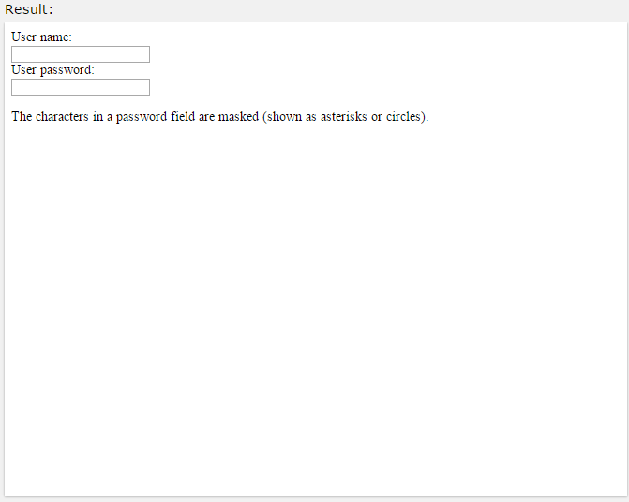
Input Type: password
<input type="password"> defines a password field:
Example
<form>
User name:<br>
<input type="text" name="username"><br> User password:<br>
<input type="password" name="psw">
</form>

Slide 11

Input Type: submit
<input type="submit"> defines a button for submitting form
The form-handler is typically a server page with a script for processing input data.
The form-handler is specified in the form's action attribute:
Example
<form action="action_page.php"> First name:<br>
<input type="text" name="firstname" value="Mickey"><br> Last name:<br>
<input type="text" name="lastname" value="Mouse"><br><br>
<input type="submit" value="Submit">
</form>

Slide 12

Input Type: radio
<input type="radio"> defines a radio button.
Radio buttons let a user select ONLY ONE of a limited number of choices:
Example
<form>
<input type="radio" name="gender" value="male" checked> Mal e<br>
<input type="radio" name="gender" value="female"> Female<br
>
<input type="radio" name="gender" value="other"> Other
</form>

Slide 13
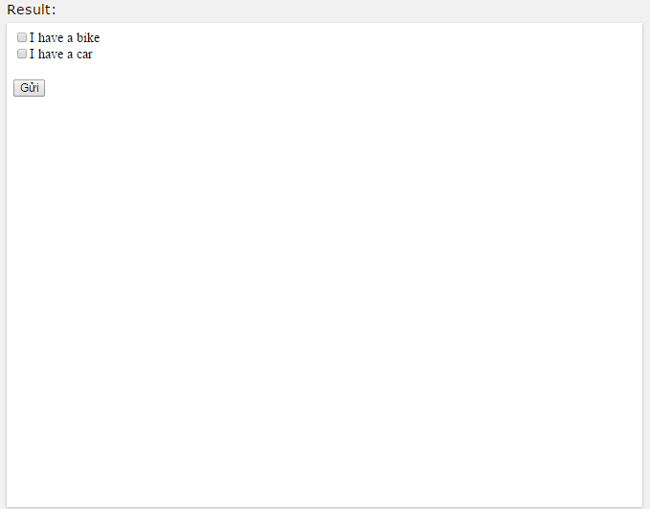
Input Type: checkbox
<input type="checkbox"> defines a checkbox.
Checkboxes let a user select ZERO or MORE options of a limited number of choices.
<form>
<input type="checkbox" name="vehicle1" value="Bike"> I have a bike<br>
<input type="checkbox" name="vehicle2" value="Car"> I have a car
</form>

Slide 14
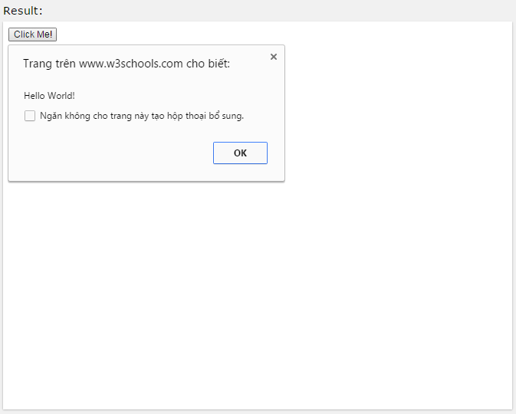
Input Type: button
<input type="button"> defines a button:
<input type="button" onclick="alert('Hello World!')" value="Click
Me!">

Slide 15
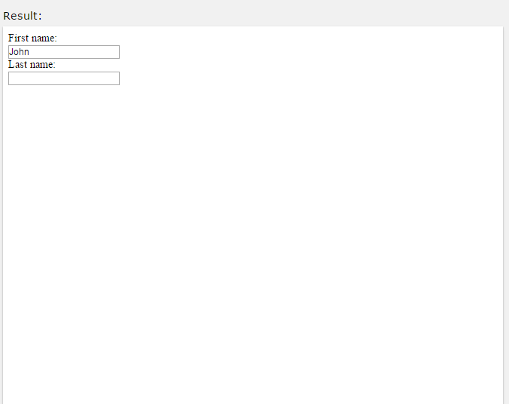
HTML Input Attributes
The value Attribute
The value attribute specifies the initial value for an input field: Example
<form action="">
First name:<br>
<input type="text" name="firstname" value="John">
<br>
Last name:<br>
<input type="text" name="lastname">
</form>

Slide 16
The readonly Attribute
The readonly attribute specifies that the input field is read only (cannot be changed):
Example
<form action="">
First name:<br>
<input type="text" name="firstname" value="John" readonly>
<br>
Last name:<br>
<input type="text" name="lastname">
</form>

Slide 17
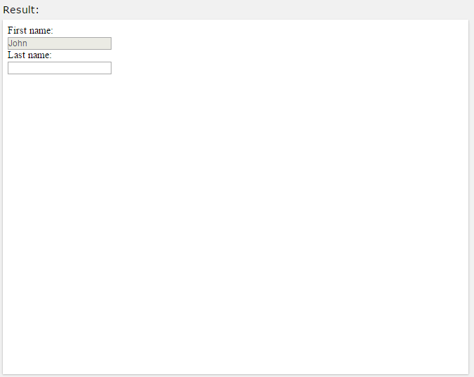
The disabled Attribute
The disabled attribute specifies that the input field is disabled. A disabled element is un-usable and un-clickable.
Disabled elements will not be submitted.
<form action="">
First name:<br>
<input type="text" name="firstname" value="John" disabled>
<br>
Last name:<br>
<input type="text" name="lastname">
</form>

Slide 18
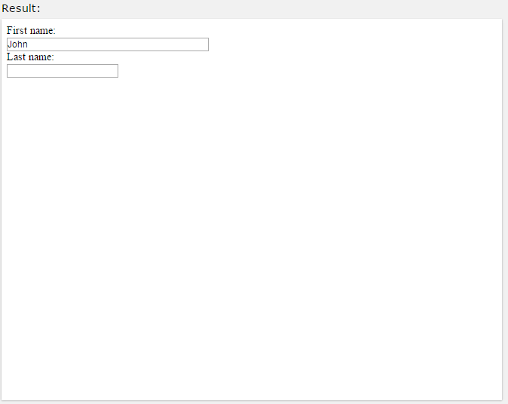
The size Attribute
The size attribute specifies the size (in characters) for the input field:
<form action="">
First name:<br>
<input type="text" name="firstname" value="John" size="40">
<br>
Last name:<br>
<input type="text" name="lastname">
</form>

Slide 19
The maxlength Attribute
The maxlength attribute specifies the maximum allowed length for the input field:
Example
<form action="">
First name:<br>
<input type="text" name="firstname" maxlength="10">
<br>
Last name:<br>
<input type="text" name="lastname">
</form>

Slide 20

The height and width Attributes
The height and width attributes specify the height and width of an <input> element.
The height and width attributes are only used with <input type="image">.
Always specify the size of images. If the browser does not know the size, the page will flicker while images load.
<input type="image" src="img_submit.gif" alt="Submit" width="4
8" height="48">

Slide 21
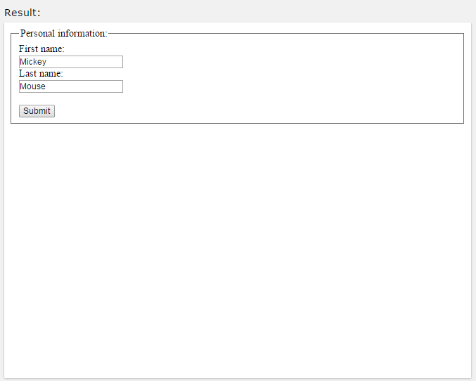
Grouping Form Data with <fieldset>
The <fieldset> element groups related data in a form.
The <legend> element defines a caption for the element.
Example
<form action="action_page.php">
<fieldset>
<legend>Personal information:</legend> First name:<br>
<input type="text" name="firstname" value="Mickey"><br>
Last name:<br>
<input type="text" name="lastname" value="Mouse"><br><br>
<input type="submit" value="Submit">
</fieldset>
</form>

